Slide 1

Ilmac Lausanne
September 28 and 29, 2022
Analytical instruments for atmospheric and environmental measurements.

Slide 2
Table of content
Presentation
2BTechnologies
UV technologie
2BTech products
Ozone Analyser
Hydrogen Analyzers
Calibrators
Aqsync
Questions

Slide 3
Introduction
Auréliane Vuilliomenet:
  Product Manager since 2021
Ozone Company, Ozone Department:
  Created in 2000
  Based in Le Locle
  Specialized in ozone solutions and air measurement products
  Customers mainly research centers and universities
  Ozone.ch changed ownership in 2011

Slide 4
About 2BTechnologies
2Btech is a small company.
Located in Boulder, Colorado, USA.
Development and marketing of new analytical instruments for atmospheric and environmental measurements.
Specializing in miniaturized instruments for the measurement of Ozone (O3)/Nitrogen Monoxide (NO)/Nitrogen Dioxide (NO2), /Hg...
We have been partners from day one, and we are their official distributor in Switzerland.

Slide 5
The UV technology for Gas measurement
It allows a very precise measurement to respond to a very wide range of oxidants as well as to reducing agents.
The ozone molecule has an absorption maximum of 254 nm.
The NO and NO2 molecule has an absorption maximum of 405 nm.
The molecule is measured as a function of light attenuation via the absorption cell.

Slide 6
1 | Scrubber IN | 7 | Pressostat | 13 | Commande
2 | Filtre IN | 8 | Scrubber OUT
3 | Vanne IN | 9 | Filtre OUT
4 | Tube Nafion | 10 | Débitmètre | 20 | Tube Nafion externe (option)
5 | Lampe | 11 | Pompe | 21 | Scrubber externe (option)
6 | Photodiode | 12 | Mesure température | 22 | Filtre externe

Slide 7
Ozone Analyzer model
POM: personal ozone monitor
Model 106 L;M;M-H; H
Options:
  NEMA: Industrisal Version
  OEM: With customization
  Multi-channel option
Model 108
Model 202 single Beam
Model 205 Dual Beam
Options for 202 and 205:
  Rackmount enclosure
Model 211

Slide 8

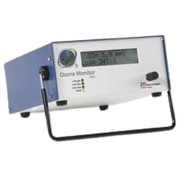
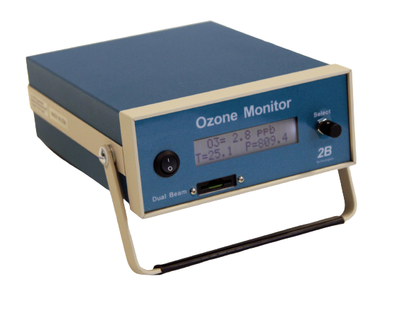
Ambient Ozone Monitors
Model 106
Model 106:
Small measuring range
Single Beam
Various models: L;M;M-H;H
Multi-Channel options
Model 205
Model 108: Same as106 but without pump
Model 205:
Wide measuring range
Dual Beam
One model only
Longer cell ass 106(increases the measuring range)

Slide 10
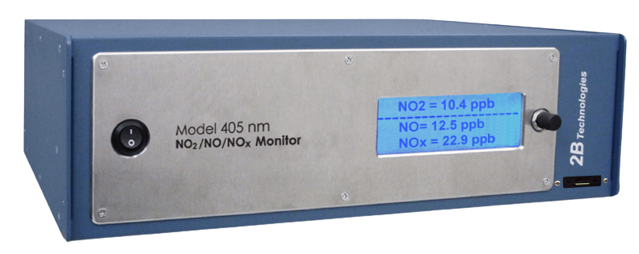
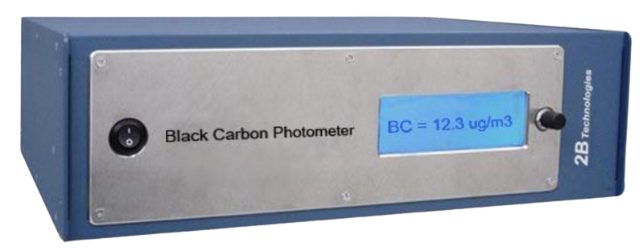
Nitrogen analysers models
Model 405 nm NO2/NO/NOx Monitor
Black Carbon Photometer

Slide 11
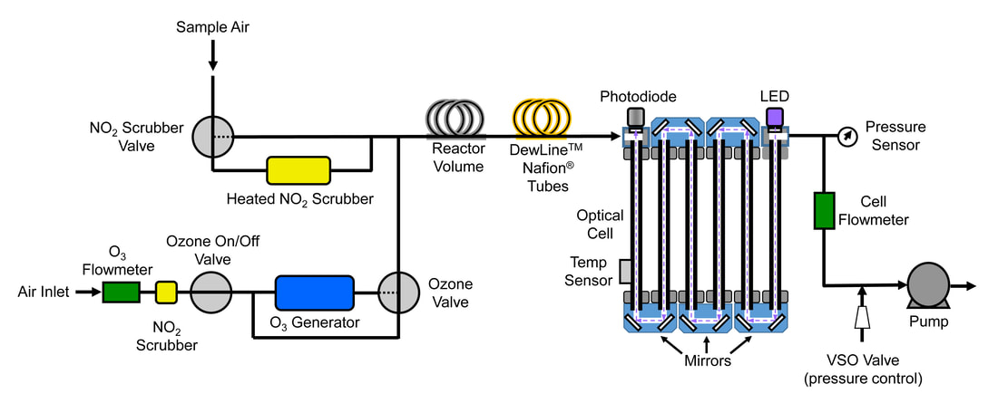
Model 405 nm NO2/NO/NOx Monitor
Dual Beam UV technology

Slide 12
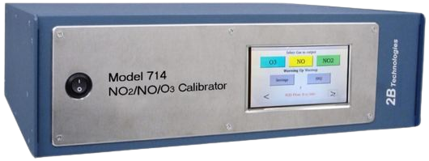
Calibrators
Model 714 NO2/NO/O3 Calibration Source
Model 306 Ozone Calibration Source
Model 408 NO Calibration Source

Slide 13
Model 714 NO2/NO/O3 Calibration Source
This device combines two models:
  The Model 408 Nitric Oxide Calibration Source™
  The Model 306 Ozone Calibration Source™
  This allows it to produce NO2, NO and O3
This calibration source is used to calibrate our analysers and to perform tests and verifications in the workshop.

Slide 14
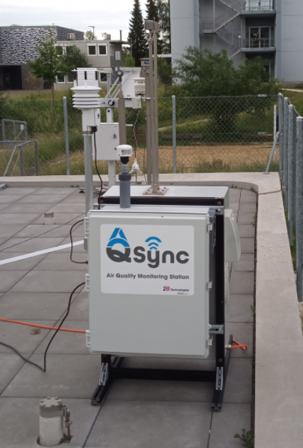
The new AQSync: Air Quality Monitoring Station
This device measures different weather parameters
  Ambient temperature (T),
  Pressure (P),
  Relative humidity (RH),
  Wind speed and direction,
Provides measurements of all major air pollutants:
Nitrogen Dioxide (NO₂)
Ozone (O₃)
Nitric Oxide (NO)
Particulate Matter (PM₁, PM_{2.5}, PM₁₀)
Carbon Dioxide (CO₂)
Carbon Monoxide (CO)
Total volatile organic compounds (TVOC)
Installation of the 1st Aqsync
in Europe at EMPA Dübendorf

Slide 15
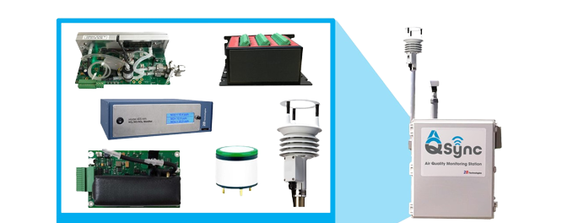
Specification and features
Composed of different 2Btech monitors :
Ozone: Model OEM-108-L
NO/NO2: Model 405 nm NO2/NO/NOx Monitor
Models external to 2B Tech:
  Particulate Matter (PM₁, PM_{2.5}, PM₁₀)
  Carbon Dioxide (CO₂)
  Carbon Monoxide (CO)
  Detailed Specifications:
  Permanently connected online
  Easy to read measurements at any time
  Compact

Slide 16
First European installation of AQsync
The first European Aqsync was set up at the EMPA of Dübendorf.
The Swiss Federal Laboratories for Materials Science and Technology,
is an interdisciplinary Swiss research institute for applied materials sciences
and technology.
The EMPA conducts research on the sources, assessment and reduction of air pollutant and noise emissions.
We went on the site for the installation and met the people who will work with this station.
The AQsync is now active thanks to the collaboration
of ozone.ch, 2BTechnologies and EMPA

Slide 17
Any questions?
Thank you for your attention
We are looking forward to meeting you at our stand C22 in hall 7 in case of further questions

